Slide 1


Algorithmic discrimination
Edita Dibrani

Slide 2


Slide 3
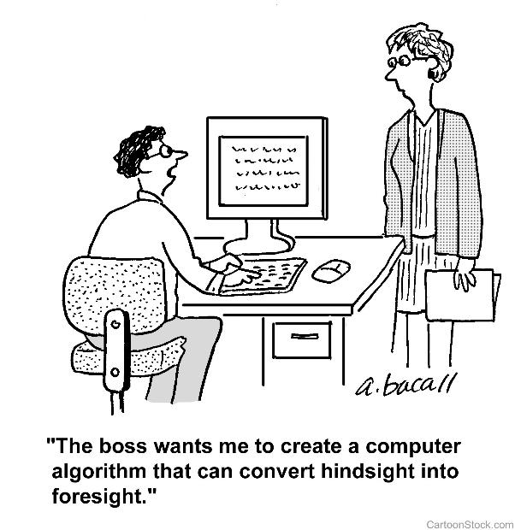

Slide 4
Discrimination factors
Biased or otherwise low quality input data
Poorly defined rules
Lack of contextual awareness
Feedback loops

Slide 5
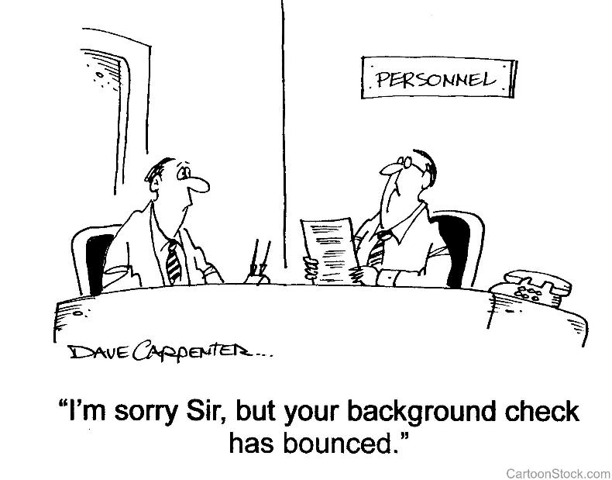

Slide 6


Slide 7
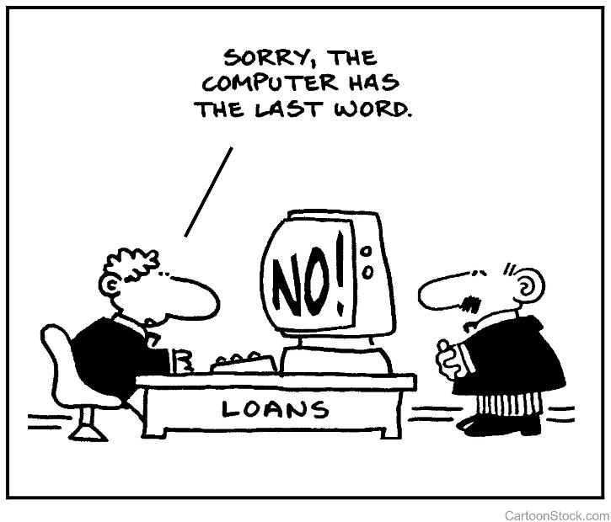

Slide 8
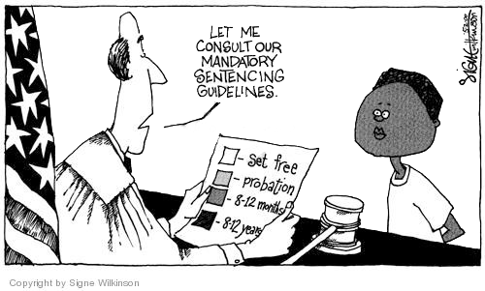

Slide 9
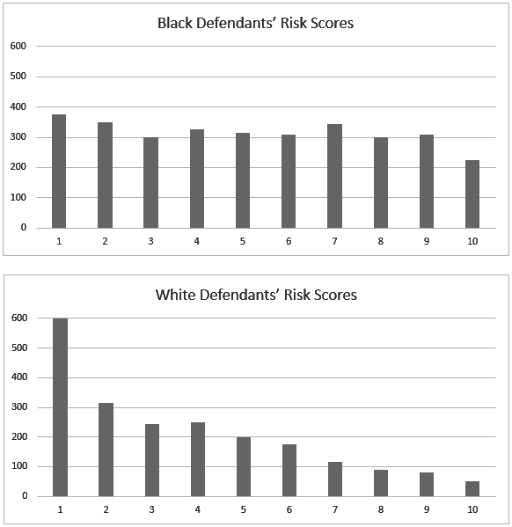

Slide 10
Principles for Accountable Algorithms
Fairness
Explainability
Auditability
Responsibility
Accuracy

Slide 11
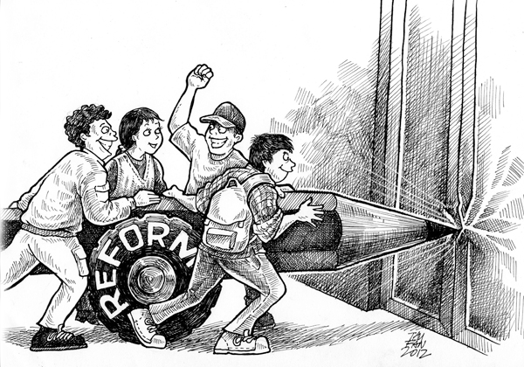

Slide 12
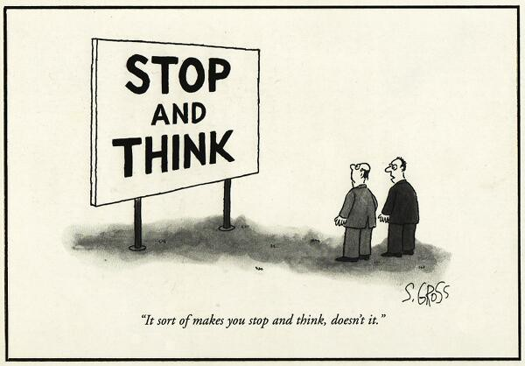

Slide 13
“We cannot outsource our moral responsibility to machines.”
– Zeynep Tufekci –

